Slide 1




Kibana Training Session - HSCC

Slide 2
Introduction
Kibana is an open-source browser-based visualization tool mainly used to analyze large volume of logs in the form of line graph, bar graph, pie charts, heat maps, region maps, coordinate maps, gauge, goals, timelion(timeline) etc.
The visualization makes it easy to predict or to see the changes in trends of errors or other significant events of the input source.
Kibana works in sync with Elasticsearch and Logstash which together forms the so-called ELK stack.

Slide 3
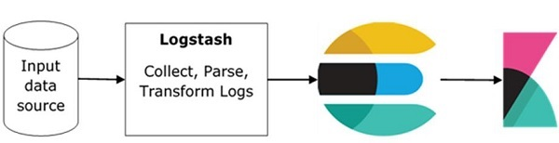
Data Flow
The basic flow of ELK Stack is shown in the image here

Slide 4
ELK
Logstash is responsible to collect the data from all the remote sources where the logs are filed and pushes the same to Elasticsearch.
Elasticsearch acts as a database where the data is collected
Kibana uses the data from Elasticsearch to represent the data to the user in the form of bar graphs, pie charts, heat maps as shown below

Slide 5
Features of Kibana
Visualization - bar chart, pie chart, line graph, heat map
Dashboard – All graphs in one board
Dev Tools –HTML, JS etc
Reports – CSV, URL
Filters and Search query - KQL
Plugins – Third party UI or API
Coordinate and Region Maps - geographical map
Timelion - time based data analysis
Canvas - Color combinations, shapes, texts

Slide 6
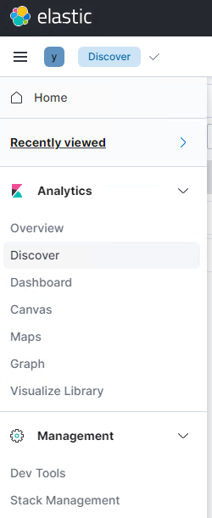
Components
Name space
Recent queries
Overview
Discover – KQL/Log search
Dashboard – Graphs
Others – Not used much

Slide 7
KQL
Below are the common key items used while log filtering in Kibana Query Language
*
AND or OR
“ ”
:
<= >= =
NOT
Time Range selection
Break down by

Slide 8
Search Examples
For YOS PROD server type below filter and select timestamp
https://kibana-prod-v8.tools.fxi-svc.az.fxei.fedex.com/s/yos
https://kibana-nonprod.tools.fxi-svc.az.fxei.fedex.com/s/yos/
1. log.level :"ERROR" and "vehicleId as null"
2. "unitName=XA199FP" and "unitId:1009539" and "movementId:12790073"

Slide 9
Create Filter and Save
Login to the Application
Go to discover
Add all the filter needed
Save the filter
Click open and select saved filter
Accessible to all

Slide 10
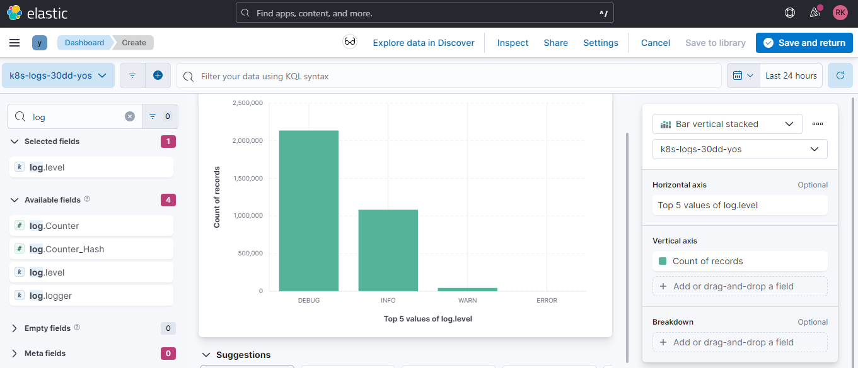
Dashboard

Slide 11
About Mphasis
Mphasis (BSE: 526299; NSE: MPHASIS) applies next-generation technology to help enterprises transform businesses globally. Customer centricity is foundational to Mphasis and is reflected in the Mphasis’ Front2Back™ Transformation approach. Front2Back™ uses the exponential power of cloud and cognitive to provide hyper-personalized (C=X2C² _{TM}=1) digital experience to clients and their end customers. Mphasis’ Service Transformation approach helps ‘shrink the core’ through the application of digital technologies across legacy environments within an enterprise, enabling businesses to stay ahead in a changing world. Mphasis’ core reference architectures and tools, speed and innovation with domain expertise and specialization are key to building strong relationships with marquee clients. Click here to know

